Slide 1
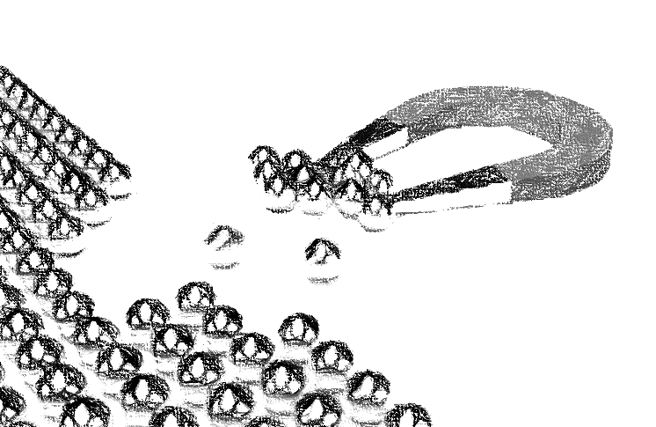
Learning Outcomes
Discuss the external and internal environment of marketing and explain how it affects a firm

Slide 2
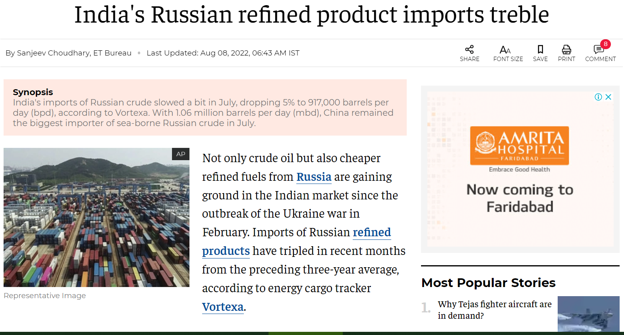

Slide 3
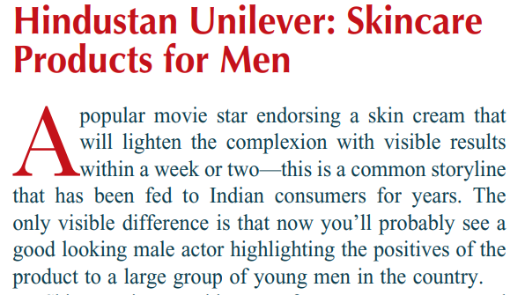

Slide 4
Marketing
Environment

Slide 5
Introduction
Marketing is akin to driving a car which requires constant monitoring of the road conditions which change with every passing moment and shifting gears accordingly.
The car driver needs be on a constant vigil to two both potential risks of accidents and opportunities to accelerate.
Like driving is a game of sensing and responding to perpetually emergent road scenario, marketing too is sport of gazing environment for spotting potential opportunities to seize them and adopting response to deftly meet challenges of threats.

Slide 6
Sensing and Responding
Why some of the animals like Pyrenean ibex, golden toad, dinosaurs and dodo which once inhabited planet earth went in to extinction?
Why some of the products, brands and organizations which once dominated their respective areas when out of market?

Slide 7
Answer: because of their failure to adapt to evolving environment

Slide 8
Business and Environment
Businesses work through an interplay with markets which represent demand.
How well a business adapts to its ever evolving environment determines its success
The environmental shifts can push an organization out its business by upsetting its strategic fit
Kodak suffered setback in its film based camera business due to digital camera and Hindustan Motors was dented by new car companies like Maruti Suzuki

Slide 9
Adaptation
Organization
Businesses work through an interplay with markets which represent demand.
How well a business adapts to its ever evolving environment determines its success
The environmental shifts can push an organization out its business by upsetting its strategic fit
Fit
Environment

Slide 10
Environmental Effects
Opportunity: an opportunity is a chance arising out of environmental shift to do business by satisfying emergent consumer needs and wants. It presents a window for an organization to earn revenue and surpluses like opportunity for green vehicles
Threat: is a development which can damage an organization’s market fit by adversely affecting its business. Threats arise out of unfavorable trend or development like the rise of health conscious consumers is a threat to unhealthy fast food marketers

Slide 11
Two Types of Environments
Two types of environments that surround an organization:
Macro environment
Micro environment

Slide 12
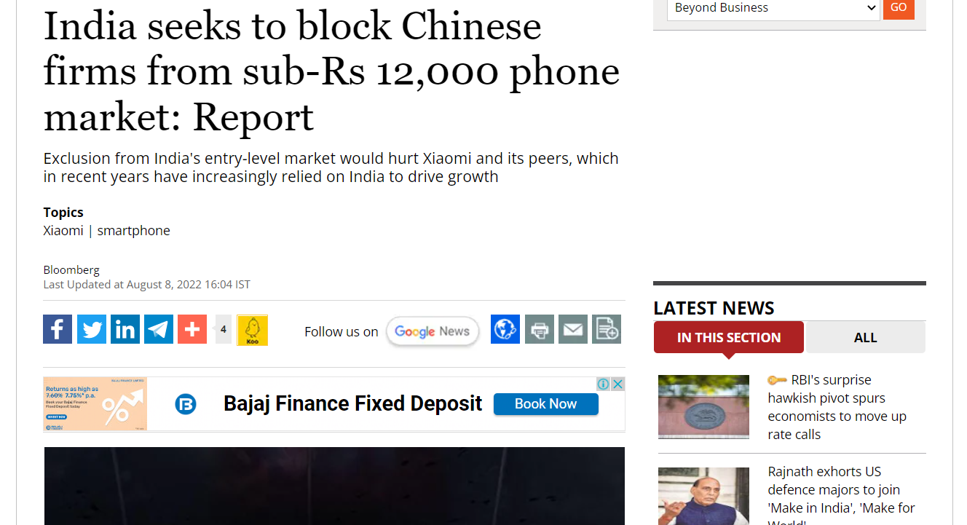

Slide 13
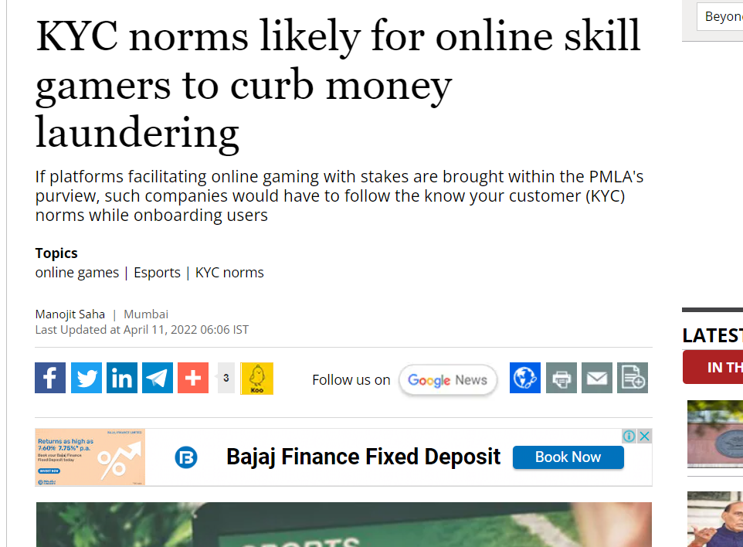

Slide 14
Macro Environment
Organization
Demographic
Socio-cultural
Economic
Political -legal
Technological
Natural

Slide 15
Macro Environment
Macro environmental factors are those that are external to organization.
They have influence on the society in a larger and more profound way
The macro environment consists of demographic environment, economic environment, socio-cultural environment, natural environment, technological environment and political legal environment.

Slide 16
Macro Environment: Demographic Environment
Demographics are the study of trends and patterns related to human population.
The demographics relate to structure and changes in the factors such as age, sex, economic status, education and religion.
The variables that interest the marketers include population growth rate, age distribution, and divisions based on ethnicities, gender mix and educational levels

Slide 17
Socio-cultural Environment
People do not live in isolation. There is always a social and cultural angle to human beings.
The beliefs, values, customs and practices of people influence the way people relate with products, services and brands
Beliefs, values and symbols are important aspects of culture
Some of the important Indian values are fear of god, collectivism, spirituality and cooperation

Slide 18
Economic Environment
The economic conditions and economic policies have a direct bearing on marketing strategies.
The economic aspects like economic system, economic orientation and policies, income levels, distribution of income, and economic resources require marketer’s attention.

Slide 19
The Economic Environment
There are many factors that are used to read the state of economy like:
Gross domestic product growth rate
Sectoral movements in manufacturing, agriculture and services sectors
Per capita income trend
Price levels
Trend in employment or unemployment level Income distribution
Inflation rate
Exchange rate and foreign reserves.

Slide 20
Technological Environment
Technology means application of scientific knowledge in devising solution of a problem.
Technology has been put to use extensively by industries like automobiles, health and electronics.
Automobiles have undergone considerable technological change in terms of its design and manufacturing.
The dynamism in technological environment has made human life better in almost all sphere of activity.
For example in entertainment there has been evolution from radio to long range players to cassette recorders to compact disc players, to black and white television to color television, to mobile television.
Changes is technology can cast doom for established players and provide opportunity to technology initiators.

Slide 21
Technological Changes in Audio Industry
Long record players
Cassette tape players
Compact disc players
Micro processor based players

Slide 22
Technological Environment: Creative Destruction
The disruptive aspect of technology was labeled by Schumpeter as ‘creative destruction’.
It means, ‘a process of industrial mutation that incessantly revolutionizes the economic structure from within, incessantly destroying the old one, incessantly creating a new one’.
At the heart of creative destruction is the arrival of disruptive technology which unexpectedly displaces and established technology like how camera firms are threatened by mobile phone companies

Slide 23
Creative Destruction: Examples
Typewriters versus computers
Physical post versus email
Film based camera versus filmless camera
Direct cool refrigerator versus frost free refrigerator
Fixed line phone versus mobile phone
Filament based bulbs versus LED bulbs

Slide 24
Types of Innovations
Continuous innovation- involves modification to existing products to improve its performance
Dynamically continuous innovation: this innovation type has disruptive effect on consumers as they need to modify or adapt their behavior.
Discontinuous innovation- it is a category of innovations require radical disruption in consumer behavior .

Slide 25
Types of Innovation: Increasing
Disruption
Continuous innovation : earthen vessel to metal vessel
Dynamically continuous innovation : metal cooking vessel to pressure cookers
Discontinuous innovation : pressure cookers to microwave

Slide 26
Political and Legal Environment
Businesses must operate within framework of law of the country.
Legal compliance is basic minimum condition.
Legally compliant requires that laws that have direct or indirect bearing on business functioning must be properly understood.
Changes in legal framework or political condition can be a source of an opportunity or threat.

Slide 27
Various Spheres of Regulations
Laws related to location, production and distribution
Laws related to employees-wages
Laws related to business formation and operation
Laws related to environment protection
Laws related to taxation
Laws related to stock market, investment and capital
Laws related to consumer protection
Laws related to trading, merchandising and marketing
Laws related to industrial disputes
Laws related to contracts
Laws related to monopolies and competition

Slide 28
Natural Environment
Business organization depends upon natural environment for essential resources
The marketing chain depends resources supplied by earth.
Excessive resource exploitation has become a contentious issue
Pervasive degradation of nature and exploitation of natural resources has led the emergence of environment protection movement globally
The issues such as bio diversity, pollution, resource shortage, deforestation, drinking water, global warming and ocean life are source of both opportunity and threat

Slide 29
Green Consumer: Levi’s New Jeans
Levi’s is a brand that pioneered rugged bottom wear that came to be known as jeans.
Levi’s recognized the environmental challenge of pollution and waste.
Sensing opportunity in waste and ecological sensitivity the company has created a novel concept of spinning jeans from garbage

Slide 30
Micro Environment: Direct Influence
The micro environment consists of factors which act in close proximity of the firm
These factors can influence an organization directly
Micro environment is made of suppliers, consumers, competitors, suppliers and publics
Their direct influence on firm and firm’s direct influence on them makes them very important

Slide 31
Micro Environment
Organization
Customers
Suppliers
Publics
Competitors
Intermediaries

Slide 32
Micro Environment
Customers
Consumer needs, preferences and bargaining power has direct bearing on marketing activities. Consumers now demand greater transparency from business.
Intermediaries
Intermediaries like retailers and logistics partner cooperation is essential. Their lack of cooperation can pose a serious threat to organization. Appointment of a new channel can invited noncooperation from current partners.
Competition
Competitors policies, objectives and behaviors directly affects marketing of a company. For instance a price reduction by a competitor can hurt sales.
Publics
Suppliers
Publics like consumer groups, banks, government, shareholders and interest groups closely monitor how an organization operates and a negative image can invite threat from them
Business depends upon suppliers for different kinds of inputs. Their cooperation must be managed. Changes in their relationship can image business negatively.

Slide 33
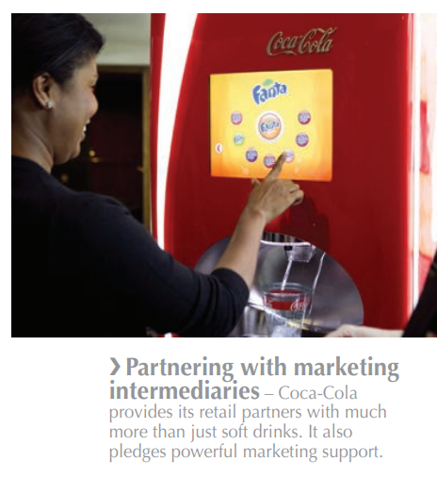

Slide 34
Maruti’s Micro Environment
Organization
Customers: individual and corporate buyers
Suppliers: electrical, tyres, battery and lube suppliers
Publics: tax authority, labor unions, consumer groups
Competitors: GM, Hyundai, Toyota
Intermediaries: service providers, distributors, retail outlets

Slide 35
Conclusion
Many animals like Pyrenean ibex, golden toad, dinosaurs and dodo have gone extinct because of their inability to adjust to changing environmental conditions
Businesses face similar threat of extinction if they fail respond to evolving environmental conditions

